Slide 1
Data and Analytics for IoT
Dr. Abbas Javed
Assistant Professor
Department of Electrical and Computer Engineering,
COMSATS University Islamabad, Lahore Campus
abbasjaved@cuilahore.edu.pk

Slide 2
Contents
An Introduction to Data Analytics for IoT: This section introduces the subject of analytics for IoT and discusses the differences between structured and unstructured data. It also discusses how analytics relates to IoT data.
Machine Learning: Once you have the data, what do you do with it, and how can you gain business insights from it? This section delves into the major types of machine learning that are used to gain business insights from IoT data.
Big Data Analytics Tools and Technology: Big data is one of the most commonly used terms in the world of IoT. This section examines some of the most common technologies used in big data today, including Hadoop, NoSQL, MapReduce, and MPP.
Edge Streaming Analytics: IoT requires that data be processed and analyzed as close to the endpoint as possible, in real-time. This section explores how streaming analytics can be used for such processing and analysis.

Slide 3
An Introduction to Data Analytics for IoT
10 GB data per second
5000 Sensors
Average 8-hour flight generates 500 TB of data daily.

Slide 4
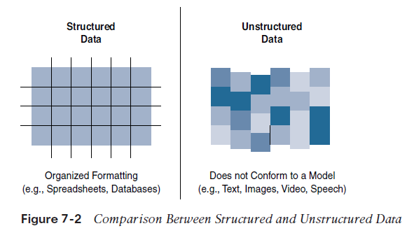
Structured Vs Unstructured Data
Structured data means that the data follows a model or schema that defines how the data is represented or organized, meaning it fits well with a traditional relational database management system (RDBMS).
Structured Data- Banking Trascations, computer log file, router configurations, IoT sensor data
Unstructured data lacks a logical schema for understanding and decoding the data through traditional programming means
80% of a business’s data is unstructured

Slide 5
Data in Motion Versus Data at Rest
data in IoT networks is either in transit (“data in motion”) or being held or stored (“data at rest”).
Examples of data in motion include traditional client/server exchanges, such as web browsing and file transfers, and email
Data saved to a hard drive, storage array, or USB drive is data at rest.
From an IoT perspective, the data from smart objects is considered data in motion as it passes through the network en route to its final destination
Spark, Storm and Flink for data in motion
Data at rest – Hadoop

Slide 6
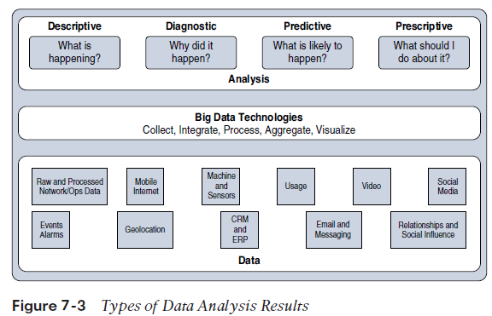
IoT Data Analytics Overview

Slide 7
Descriptive: Descriptive data analysis tells you what is happening, either now or in the past. For example, a thermometer in a truck engine reports temperature values every second.
Diagnostic: When you are interested in the “why,” diagnostic data analysis can provide the answer. Continuing with the example of the temperature sensor in the truck engine, you might wonder why the truck engine failed. Diagnostic analysis might show that the temperature of the engine was too high, and the engine overheated.
Predictive: Predictive analysis aims to foretell problems or issues before they occur. For example, with historical values of temperatures for the truck engine, predictive analysis could provide an estimate on the remaining life of certain components in the engine.

Slide 8
Prescriptive: Prescriptive analysis goes a step beyond predictive and recommends solutions for upcoming problems. A prescriptive analysis of the temperature data from a truck engine might calculate various alternatives to cost-effectively maintain our truck. These calculations could range from the cost necessary for more frequent oil changes and cooling maintenance to installing new cooling equipment on the engine or upgrading to a lease on a model with a more powerful engine.
Figure 7-4 Application of Value and Complexity Factors to the Types of Data Analysis

Slide 9
IoT Data Analytics Challenges
Scaling problems: Due to the large number of smart objects in most IoT networks that continually send data, relational databases can grow incredibly large very quickly. This can result in performance issues that can be costly to resolve, often requiring more hardware and architecture changes.
Volatility of data: With relational databases, it is critical that the schema be designed correctly from the beginning. Changing it later can slow or stop the database from operating. Due to the lack of flexibility, revisions to the schema must be kept at a minimum. IoT data, however, is volatile in the sense that the data model is likely to change and evolve over time. A dynamic schema is often required so that data model changes can be made daily or even hourly.
To deal with challenges like scaling and data volatility, a different type of database, known as NoSQL, is being used

Slide 10
Machine Learning
Machine learning is indeed central to IoT
Data collected by smart objects needs to be analyzed, and intelligent actions need to be taken based on these analyses
Machine learning is, in fact, part of a larger set of technologies commonly grouped under the term artificial intelligence (AI).
AI includes any technology that allows a computing system to mimic human intelligence using any technique, from very advanced logic to basic “if-then-else” decision loops- A simple example is an app that can help you find your parked car.
In more complex cases, static rules cannot be simply inserted into the program because they require parameters that can change or that are imperfectly understood-

Slide 11
Machine Learning
typical example is a dictation program that runs on a computer The program is configured to recognize the audio pattern of each word in a dictionary, but it does not know your voice’s specifics—your accent, tone, speed, and so on. You need to record a set of predetermined sentences to help the tool match well-known words to the sounds you make when you say the words. This process is called machine learning.
ML is a vast field but can be simply divided in two main categories: supervised and unsupervised learning

Slide 12
Supervised Learning
In supervised learning, the machine is trained with input for which there is a known correct answer
Example- training a system to recognize when there is a human in a mine tunnel
A sensor equipped with a basic camera can capture shapes and return them to a computing system that is responsible for determining whether the shape is a human or something else (such as a vehicle, a pile of ore, a rock, a piece of wood, and so on.
With supervised learning techniques, hundreds or thousands of images are fed into the machine, and each image is labeled (human or nonhuman in this case). This is called the training set.
Each new image is compared to the set of known “good images,” and a deviation is calculated to determine how different the new image is from the average human image and, therefore, the probability that what is shown is a human figure. This process is called classification.

Slide 13
Supervised Learning
Before real field deployments, the machine is usually tested with unlabeled pictures—this is called the validation or the test
The learning process is not about classifying
For example, the speed of the flow of oil in a pipe is a function of the size of the pipe, the viscosity of the oil, pressure, and a few other factors. When you train the machine with measured values, the machine can predict the speed of the flow for a new, and unmeasured, viscosity. This process is called regression; regression predicts numeric values, whereas classification predicts categories.

Slide 14
Unsupervised Learning
Unsupervised learning- there is not a “good” or “bad” answer known in advance.
It is the variation from a group behavior that allows the computer to learn that something is different
Example- Engine Manufacturing- you may decide to group the engines by the sound they make at a given temperature. A standard function to operate this grouping, K-means clustering

Slide 16
Neural Networks
Neural networks are ML methods that mimic the way the human brain works.
When you look at a human figure, multiple zones of your brain are activated to recognize colors, movements, facial expressions, and so on. Your brain combines these elements to conclude that the shape you are seeing is human.
Neural networks mimic the same logic. The information goes through different algorithms (called units), each of which is in charge of processing an aspect of the information.
For example, a neural network processing human image recognition may have two units in a first layer that determines whether the image has straight lines and sharp angles—because vehicles commonly have straight lines and sharp angles, and human figures do not. If the image passes the first layer successfully (because there are no or only a small percentage of sharp angles and straight lines), a second layer may look for different features (presence of face, arms, and so on), and then a third layer might compare the image to images of various animals and conclude that the shape is a human (or not).

Slide 18
Machine Learning and Getting Intelligence from Big Data
Local learning: In this group, data is collected and processed locally, either in the sensor itself (the edge node) or in the gateway (the fog node).
Remote learning: In this group, data is collected and sent to a central computing unit (typically the data center in a specific location or in the cloud), where it is processed.

Slide 19
Monitoring: Smart objects monitor the environment where they operate. Data is processed to better understand the conditions of operations
Behavior control: Monitoring commonly works in conjunction with behavior control. When a given set of parameters reach a target threshold—defined in advance (that is, supervised) or learned dynamically through deviation from mean values (that is, unsupervised)—monitoring functions generate an alarm. This alarm can be relayed to a human, but a more efficient and more advanced system would trigger a corrective action, such as increasing the flow of fresh air in the mine tunnel, turning the robot arm, or reducing the oil pressure in the pipe.

Slide 20
Operations optimization: Behavior control typically aims at taking corrective actions based on thresholds. However, analyzing data can also lead to changes that improve the overall process. For example, a water purification plant in a smart city can implement a system to monitor the efficiency of the purification process based on which chemical (from company A or company B) is used, at what temperature, and associated to what stirring mechanism (stirring speed and depth). Neural networks can combine multiples of such units, in one or several layers, to estimate the best chemical and stirring mix for a target air temperature.

Slide 21
Self-healing, self-optimizing: A fast-developing aspect of deep learning is the closed loop. ML-based monitoring triggers changes in machine behavior (the change is monitored by humans), and operations optimizations

Slide 22
Big Data Analytics Tools and Technology
Big data analytics can consist of many different software pieces that together collect, store, manipulate, and analyze all different data types.
Velocity: Velocity refers to how quickly data is being collected and analyzed. Hadoop Distributed File System is designed to ingest and process data very quickly. Smart objects can generate machine and sensor data at a very fast rate and require database or file systems capable of equally fast ingest functions.
Variety: Variety refers to different types of data. Often you see data categorized as structured, semi-structured, or unstructured. Different database technologies may only be capable of accepting one of these types. Hadoop is able to collect and store all three types. This can be beneficial when combining machine data from IoT devices that is very structured in nature with data from other sources, such as social media or multimedia, that is unstructured.
Volume: Volume refers to the scale of the data. Typically, this is measured from gigabytes on the very low end to petabytes or even exabytes of data on the other extreme. Generally, big data implementations scale beyond what is available on locally attached storage disks on a single node. It is common to see clusters of servers that consist of dozens, hundreds, or even thousands of nodes for some large deployments

Slide 23
Massively Parallel Processing Databases
Massively parallel processing (MPP) databases were built on the concept of the relational data warehouses but are designed to be much faster, to be efficient, and to support reduced query times
these database types process massive data sets in parallel across many processors and nodes
MPP architecture (see Figure 7-7) typically contains a single master node that is responsible for the coordination of all the data storage and processing across the cluster. It operates in a “shared-nothing” fashion, with each node containing local processing, memory, and storage and operating independently

Slide 25
NoSQL Databases
NoSQL (“not only SQL”) is a class of databases that support semi-structured and unstructured data, in addition to the structured data handled by data warehouses and MPPs. NoSQL is not a specific database technology; rather, it is an umbrella term that encompasses several different types of databases, including the following:
Document stores: This type of database stores semi-structured data, such as XML or JSON. Document stores generally have query engines and indexing features that allow for many optimized queries.
Key-value stores: This type of database stores associative arrays where a key is paired with an associated value. These databases are easy to build and easy to scale.

Slide 26
Wide-column stores: This type of database stores similar to a key-value store, but the formatting of the values can vary from row to row, even in the same table.
Graph stores: This type of database is organized based on the relationships between elements. Graph stores are commonly used for social media or natural language processing, where the connections between data are very relevant.
key-value stores and document stores tend to be the best fit for what is considered “IoT data.
NoSQL key-value stores are capable of handling indexing and persistence simultaneously at a high rate. This makes it a great choice for time-series data sets, which record a value at a given interval of time, such as a temperature or pressure reading from a sensor.

Slide 27
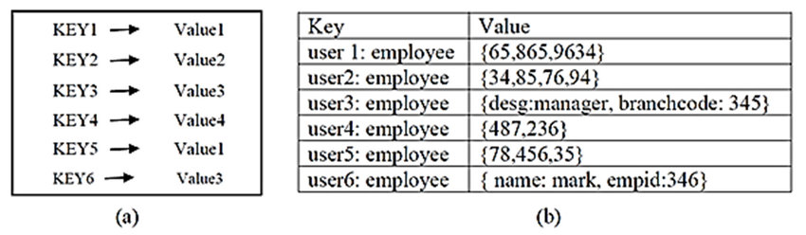
Key-Value Database

Slide 28
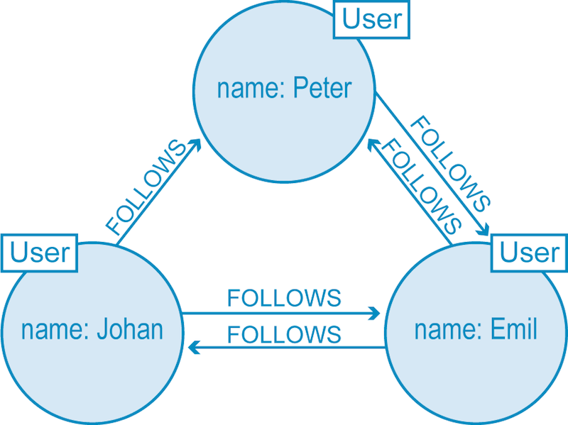
Graph Store

Slide 29
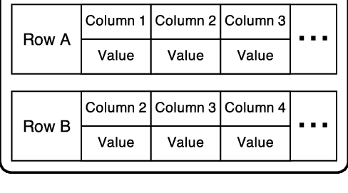

Slide 30
Hadoop
Hadoop is the most recent entrant into the data management market, but it is arguably the most popular choice as a data repository and processing engine. Hadoop was originally developed as a result of projects at Google and Yahoo!
original intent for Hadoop was to index millions of websites and quickly return search results for open source search engines.
Hadoop Distributed File System (HDFS): A system for storing data across multiple nodes
MapReduce: A distributed processing engine that splits a large task into smaller ones that can be run in parallel

Slide 32
Both MapReduce and HDFS take advantage of this distributed architecture to store and process massive amounts of data and are thus able to leverage resources from all nodes in the cluster
For HDFS, this capability is handled by specialized nodes in the cluster, including NameNodes and DataNodes

Slide 33
NameNodes: These are a critical piece in data adds, moves, deletes, and reads on HDFS. They coordinate where the data is stored, and maintain a map of where each block of data is stored and where it is replicated
All interaction with HDFS is coordinated through the primary (active) NameNode, with a secondary (standby) NameNode notified of the changes in the event of a failure of the primary
The NameNode takes write requests from clients and distributes those files across the available nodes in configurable block sizes, usually 64 MB or 128 MB blocks.
The NameNode is also responsible for instructing the DataNodes where replication should occur.

Slide 34
DataNodes: These are the servers where the data is stored at the direction of the NameNode.
It is common to have many DataNodes in a Hadoop cluster to store the data.
Data blocks are distributed across several nodes and often are replicated three, four, or more times across nodes for redundancy.
Once data is written to one of the DataNodes, the DataNode selects two (or more) additional nodes, based on replication policies, to ensure data redundancy across the cluster

Slide 36
YARN
Introduced with version 2.0 of Hadoop, YARN (Yet Another Resource Negotiator) was designed to enhance the functionality of MapReduce
MapReduce was responsible for batch data processing and job tracking and resource management across the cluster
YARN was developed to take over the resource negotiation and job/task tracking, allowing MapReduce to be responsible only for data processing

Slide 37
The Hadoop Ecosystem
Apache Kafka: The process of collecting data from a sensor or log file and preparing it to be processed and analyzed is typically handled by messaging systems.
Messaging systems are designed to accept data, or messages, from where the data is generated and deliver the data to stream processing engines such as Spark Streaming or Storm
It is composed of topics, or message brokers, where producers write data and consumers read data from these topics
Due to the distributed nature of Kafka, it can run in a clustered configuration that can handle many producers and consumers simultaneously and exchanges information between nodes, allowing topics to be distributed over multiple nodes.

